Slide 1
Smart Tutor Knowledge Hub
Group One: Jaee Oh, Lu Chen, Ehsan Haghian, Peter Martin, Sally Johnstone
April 23, 2025
Notes:
Sally
For our project, we created a knowledge hub for the Smart Tutor project.

Slide 2
Objective: Create a scalable, sustainable, automated process to build and update a searchable database of machine learning and data science resources
Notes:
Sally
We wanted to create a scalable, so that the universe of resources could be expanded over time, sustainable, so that the code was replicable across users to update search key words and resources, automated process to build and update at will a searchable database of machine learning, artificial intelligence, and data science resources.

Slide 3
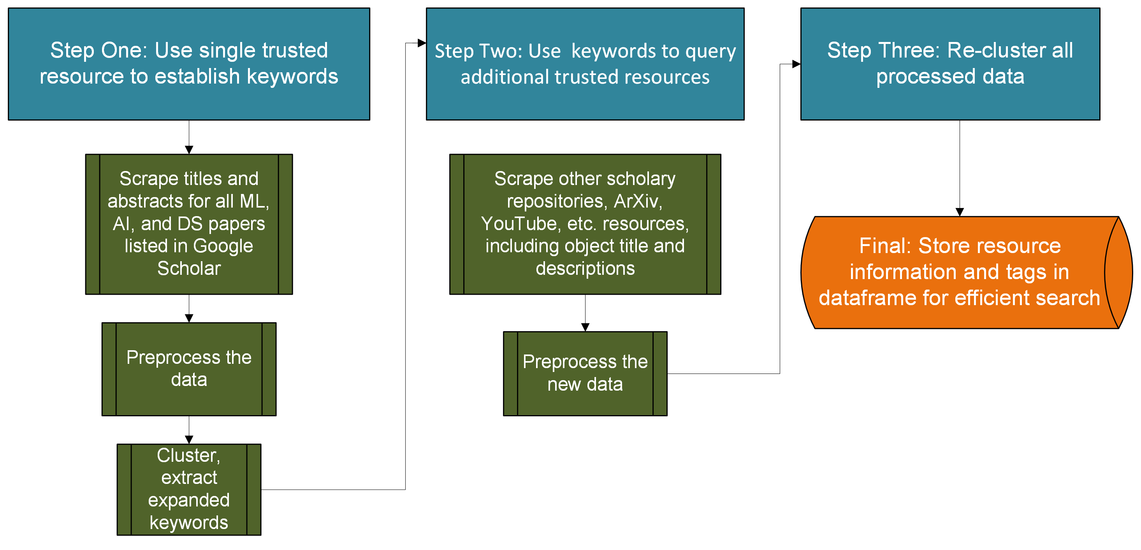
Notes:
Sally
This is how our project unfolded. First, we used a trusted resource – Google Scholar - to gather a large number of academic papers around machine learning, artificial intelligence, and data science and executed clustering analysis on that limited dataset. We then used those clusters to create an expanded list of key words for additional web scrapping. All of the resources, both the initial group and the additional trusted sources are combined and clustered again and then stored in a dataframe for efficient search. We built a testing tool to verify that the searches were working. Eventually, tags for level of difficulty and other relevant information can be added to the resources. The code and directions for execution are stored in a GitHub repository so that it can be run again in the future to update keywords to capture new topics as well as add resources. Now I will turn it over to Lu

Slide 4
Initial resource scrape
Notes:
Lu, to talk about the work she had to do with captcha, etc.

Slide 5
Initial resource scraping
Initial scraping was limited to one easy-to-access and relatively comprehensive site, to identify key words for later augmented scraping
Initial keywords for the first search was manually chosen.
Google scholar for first iteration
Notes:
Lu
First keywords: e.g. # Machine Learning Variants
"Machine Learning in Healthcare",
"Machine Learning in Finance",
# Computer Vision
"Image Recognition",
"Medical Image Analysis",

Slide 6
Preprocessing
Notes:
Lu

Slide 7
Preprocessing
Before generating embeddings, the text is preprocessed:
If abstract data is missing, field is populated with title of resource
Force lower case
Numbers removed
Punctuation removed
Whitespace trimmed
Lemmatization
Notes:
Lu
Missing abstract data is filled in using the title of the instance
Lower case is forced and numbers removed as they likely to contribute little semantic data
Punctuation is removed to focus purely on text
Lemmatization is also part of the pre-processing

Slide 8
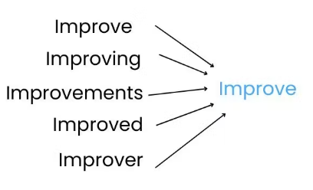
Lemmatization – Example
Original:
Artificial intelligence has impacted many aspects of human life. This paper
studies the impact of artificial intelligence on economic theory. In particular
we study the impact of artificial intelligence on the theory of bounded
rationality, efficient market hypothesis and prospect theory.
After:
artificial intelligence have impact many aspect of human life this paper
study the impact of artificial intelligence on economic theory in particular
we study the impact of artificial intelligence on the theory of bound
rationality efficient market hypothesis and prospect theory
Notes:
Lu
Lemmatization Improves TF-IDF, word embeddings, and classification accuracy. The process first tags which part of speech a word belongs to and then looks it up in its dictionary to identify the base, or lemma, of the word. Once the words are lemmatized, they are returned to the text for the next step of analysis. We used spacy which uses contextual tagging for even greater accuracy in the output.

Slide 9
Embedding
Notes:
Sally

Slide 10
Text embedding using Sentence-BERT
Older embedding methods process words in isolation
Sentence-BERT understands full sentences in context of other sentences
Semantically similar sentences are closer together in space
Semantically similar abstracts are also closer together in space
Enables clustering based on entire contents of the abstract
Used pre-trained model 'all-MiniLM-L6-v2' from Sentence Transformer library
Efficient version of SBERT optimized for speed and memory efficiency
Six transformer layers vs. 12 or 24 in standard BERT
Outputs 384-dimensional vectors vs. 768 or 1024 in larger models
Notes:
Sally
The abstracts from the dataset are embedded using Sentence-BERT, one of the more modern approaches to text embedding. Whereas older embedding methods process words in isolation, SBERT understands full sentences in the context of other sentences. Semantically similar sentences are closer together in space. Likewise, semantically similar abstracts are also closer together in space, allowing us to divide them into clusters based on the contents of the paper's abstract.
We used a pre-trained model from the Sentence Transformer library which is a version of SBERT optimized for speed and resource constraint. It dos this by using six transformer layers rather than the 12 or 24 standard in BERT and it outputs lower dimensional vectors than the larger, slower models do.

Slide 11
Dimensionality Reduction
Notes:
Ehsan

Slide 12
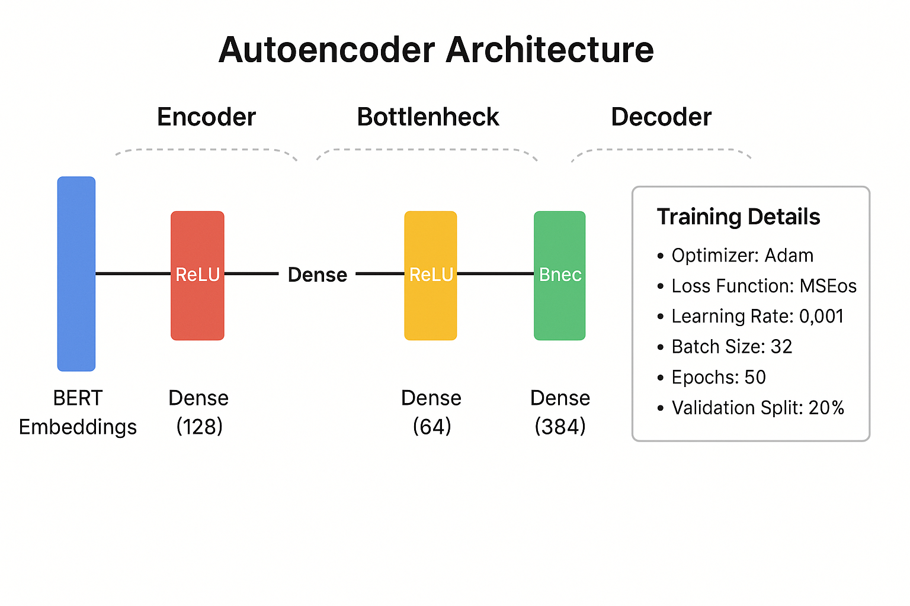
Dimensionality reduction using autoencoder
Notes:
Ehsan

Slide 13
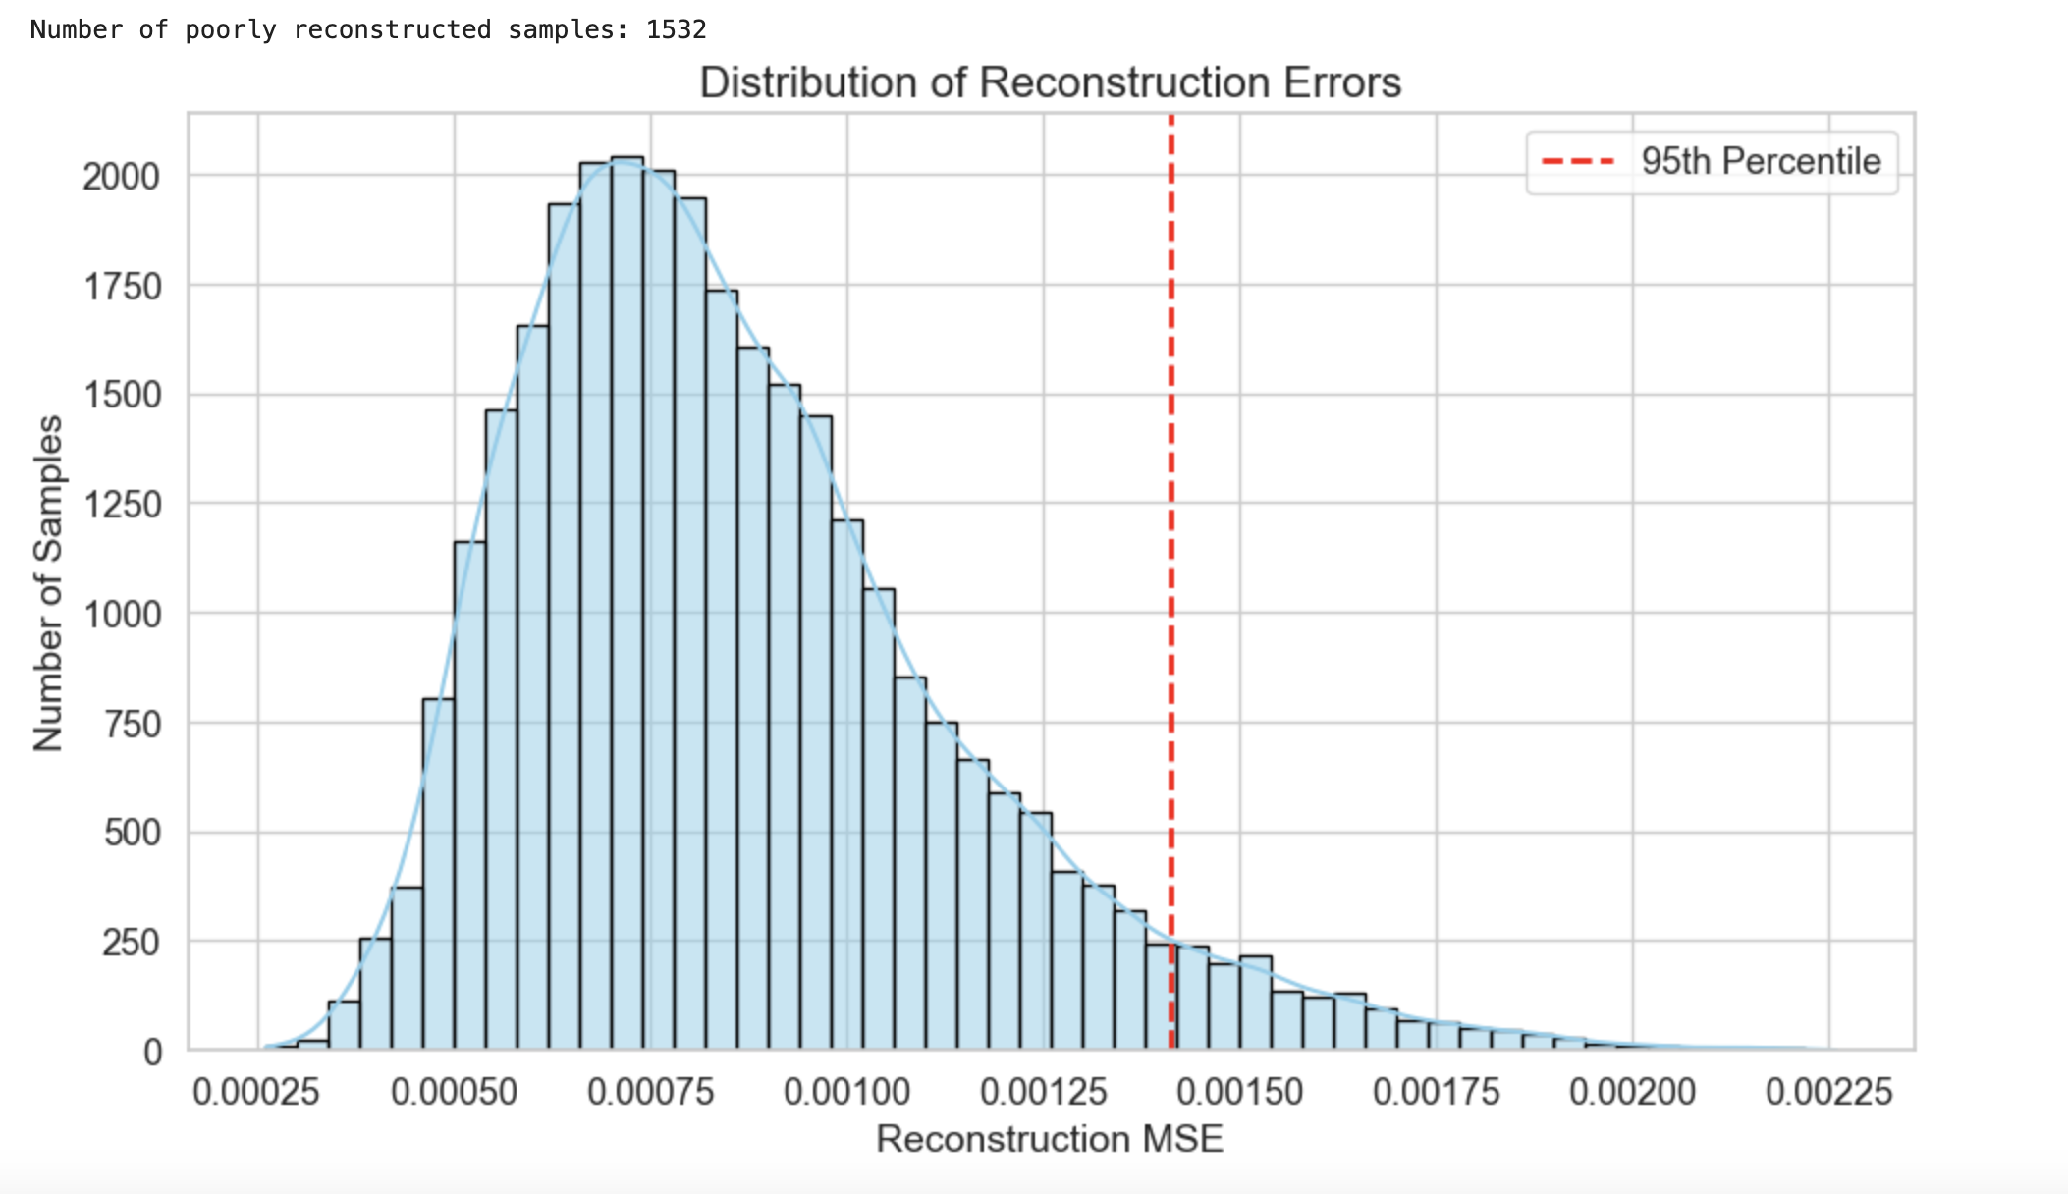
Distribution of Reconstruction Error
Bell-shaped and slightly right-skewed
Few high-error outliers
95% of the data had Perfect reconstruction
Notes:
Ehsan

Slide 14
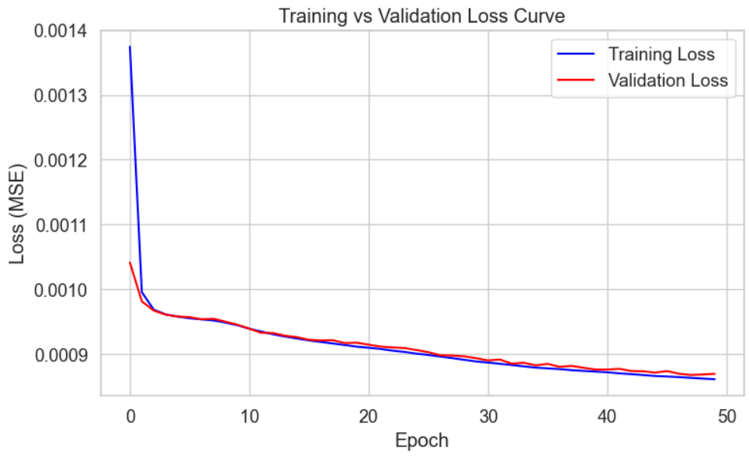
Training versus validation loss curve
Training and validation loss decrease steadily
No overfitting or underfitting evident
Convergence is smooth and stable, looks to be approaching a plateau
Notes:
Ehsan

Slide 15
Clustering
K-means and Gaussian Mixture Modeling
Notes:
Jaee

Slide 16
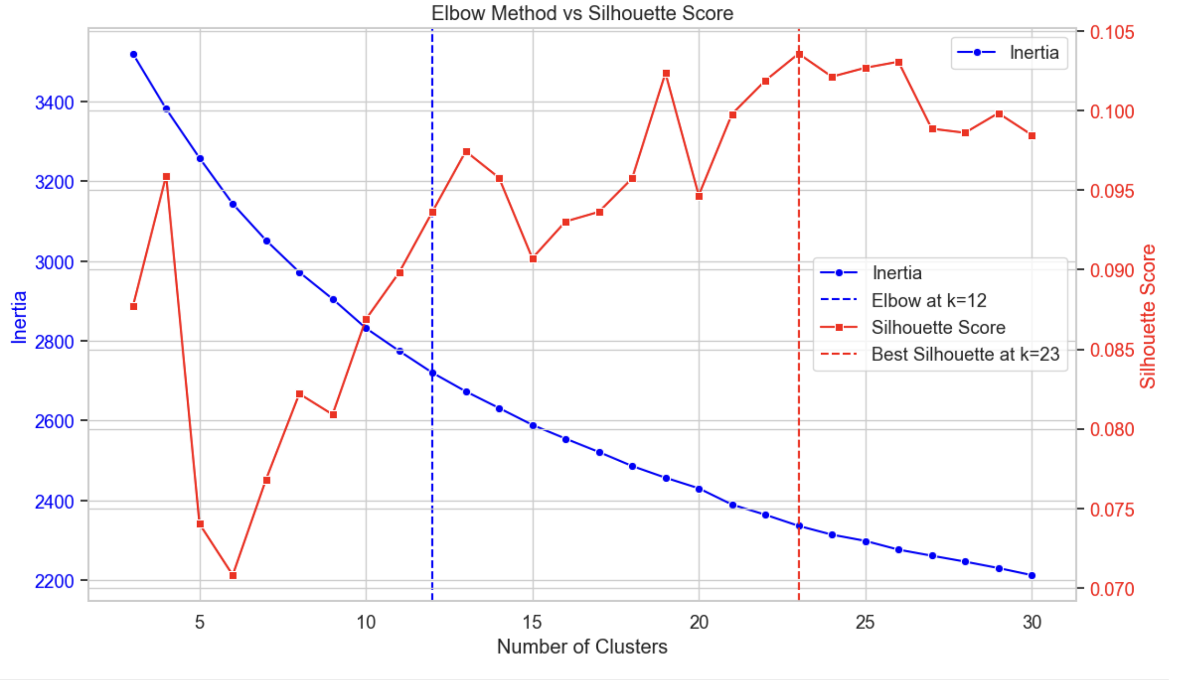
WSS and silhouette score for optimal k for k-means
Notes:
Jaee
Mention autoencoder is used

Slide 17
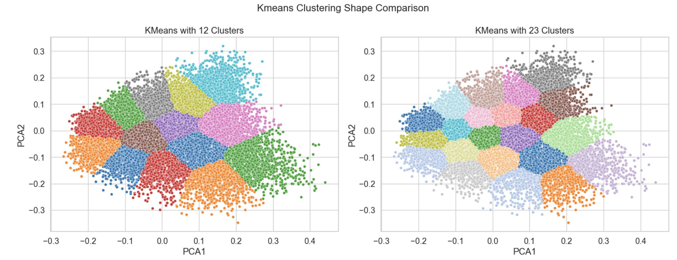
K-means test with 12 and 23 clusters
Notes:
Jaee
Mention it is PCA (for visualization only)

Slide 18
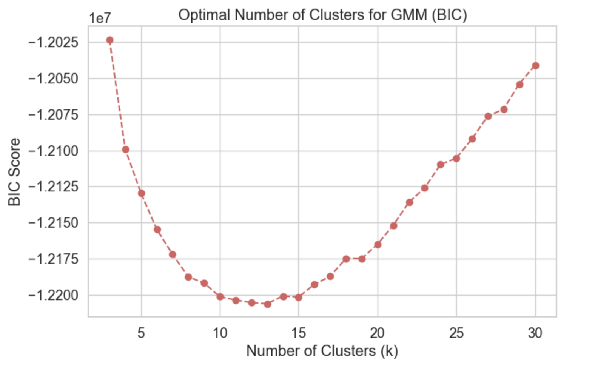
BIC for optimal k for GMM
Notes:
Jaee

Slide 19
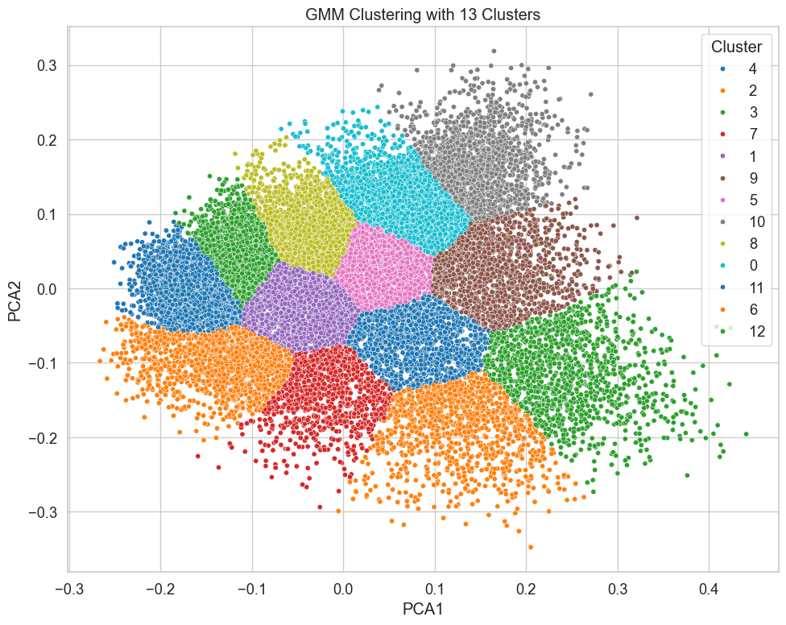
GMM results
Notes:
Jaee

Slide 20
K-means vs GMM
Both K-means and GMM show very similar results.
K-means is computationally cheaper.
~2min(K-means) vs ~10min(GMM)
K-means worked better on smaller dataset, while K-means and GMM were similar on larger dataset.
We chose K-means with wider dataset size.
There is an option to select different models by users.
Notes:
Jaee

Slide 21
Creating keyword.txt
Notes:
Peter

Slide 22
Model and Extraction
Used K-means with k = 23 to create semantically coherent groups
TfidfVectorizer to identify most representative terms for each cluster
TF-IDF-scores averaged to extract top keywords
Non-zero key words in each cluster ranged from 1,635 to 1,967
Cluster interpretation based on top 10 keys words.
Allows grouping and summarizing of documents without manual labeling
Notes:
Peter

Slide 23
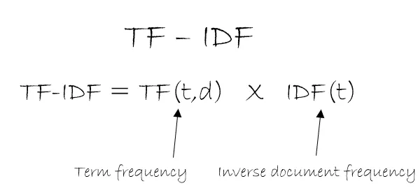
TF-IDF
Term Frequency-Inverse Document Frequency
Measure of word importance to body of text.
TF = instances of word appearance divided by total number of terms in document
IDF = log of the result of the total number of documents in the data divided by the number of documents in the text containing the word
Notes:
Peter

Slide 24
Cluster topics (sample)
Cluster 2 — Top Keywords: ai, clinical, medical, patients, health, healthcare, disease, data, machine, learning (AI and healthcare)
Cluster 10 — Top Keywords: learning, deep, networks, neural, network, data, training, models, machine, convolutional (Deep learning and neural network)
Cluster 12 — Top Keywords: language, models, model, tasks, bert, text, pretrained, neural, large, natural (Natural language processing)
Cluster 15 — Top Keywords: reinforcement, learning, rl, policy, control, deep, policies, agent, reward, agents (Reinforcement learning)
Notes:
Peter

Slide 25
Augmenting data
Notes:
Ehsan

Slide 26
Testing the process
User query is embedded with BERT and compressed using an autoencoder
Kmeans clustering finds the most relevant document group for the query
Cosine similarity filters documents with score > 0.50
Title-based reclustering refines and ranks results for fast, accurate search
Notes:
Ehsan
Notes, not a script:
In the user interface step, the user types in the search query, like one single or few keywords or a sentence. The system turns this query into a vector using the BERT model and autoencoder . Then, it finds which cluster the query is most similar to, by comparing it to the clusters that we calculated earlier using GMM. This helps narrow down the search to the documents in the related clusters instead of going through all 30,630 papers. Within that target cluster, the system calculates how similar each document is to the query using cosine similarity and keeps only the ones that are good match or if the similarity score is above 0.50 , the paper is selected as the most relevant.
If similar documents found, the system applies a second layer of filtering. This time, it looks only at the titles of papers that are selected on the first layer and groups them into smaller clusters . The query is then matched to one of these smaller "title clusters" to find the most closely related results. Finally, it ranks the results by how similar they are to the query and returns the top ones by showing their titles, URLs, and similarity scores. This two-step process "first using the Abstract embeddings, then refining with titles " makes the search faster, more accurate, and more useful for the user.
The following method combines semantic embeddings, dimensionality reduction, and hierarchical clustering to retrieve relevant documents based on a user's query. First, each document is encoded using a Sentence-BERT model to capture deep semantic meaning. These high-dimensional embeddings are then compressed using an autoencoder, which reduces noise and preserves core structure. Kmeans Model is applied to the embeddings to group documents into high-level semantic clusters. When a user submits a query, it undergoes the same encoding and reduction process, is assigned to a cluster, and is compared to the cluster's documents using cosine similarity. A second layer of clustering is then applied to document titles to refine the results even further, ensuring that the final recommendations are both thematically and topically relevant.

Slide 27

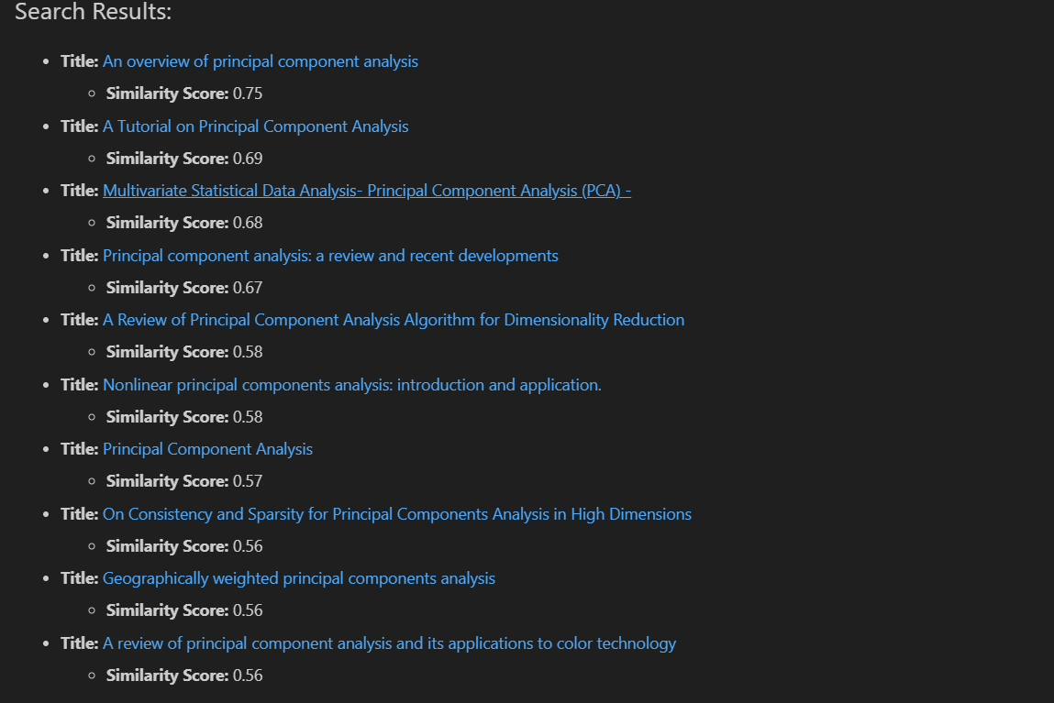
Search results
Notes:
Ehsan

Slide 28
Iteration
Notes:
Jaee

Slide 29
Iteration through Output Keywords
The output keywords of the clusters will be used as the input keywords of next iteration.
This is to separate the initial clusters to smaller clusters with sub-topics within.
Number of iterations can be chosen by users.
The resultant topics & sub-topics will create a tree structure.
The resultant tree will be used to search through different resources.
Currently available: Arxiv, MachineLearningMastery, Medium, Youtube
Notes:
Jaee

Slide 30
Conclusion
We created a framework to generate a clustered database related to machine learning.
Currently, Autoencoder, PCA (visualization) and K-means are used for the clustering.
Users can choose different options.
K-means had more flexible usage for our current dataset.
Topic keywords generated still need additional interpretation to be summarized into a short phrase, rather than 10 different words.
Notes:
Jaee

Slide 31
Create a scalable, sustainable, automated process to build and update a searchable database of machine learning and data science resources
Did we meet our objective?
Process is scalable to accommodate additional resources
Process is repeatable so that keywords and resources can be updated
Process is automated
Notes:
Jaee

Slide 32
Thank you!

